Slide 1

UNIT-I Introduction to information system CAP404 INFORMATION SECURITY AND PRIVACY
SCHOOL OF COMPUTER APPLICATIONS
DOMAIN: AI &ML

Slide 2
Information System(IS)
A system that collects, processes, stores, and shares information.
It helps organizations perform daily operations efficiently.
It supports communication, decision-making, and problem solving.
IS helps improve efficiency, communication, and productivity.
Examples: Banking systems, e-commerce websites, university management systems.

Slide 3
Basics of Information Systems
Input: Data is entered into the system from users, devices, or other sources.
Processing: The system processes the data using software and procedures.
Output: Processed information is presented as reports, charts, messages, or dashboards.
Storage: Information is stored in databases for future use and retrieval.

Slide 4
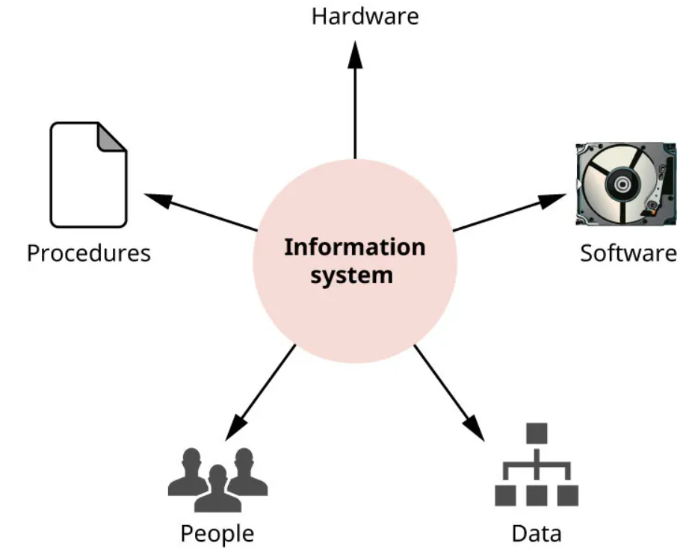
Components of Information System

Slide 5
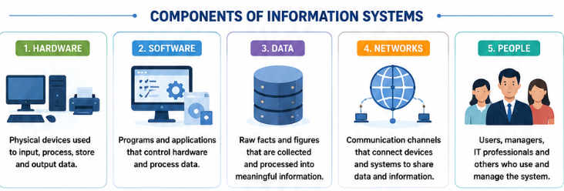

Slide 6
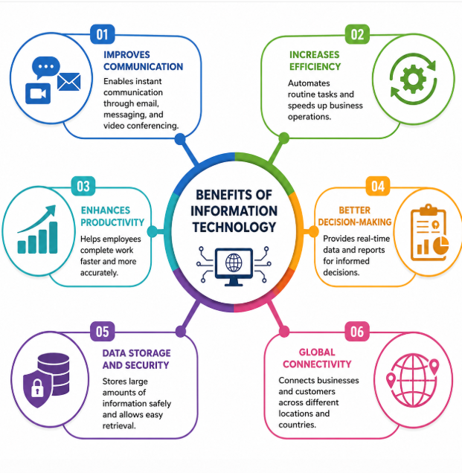

Slide 7
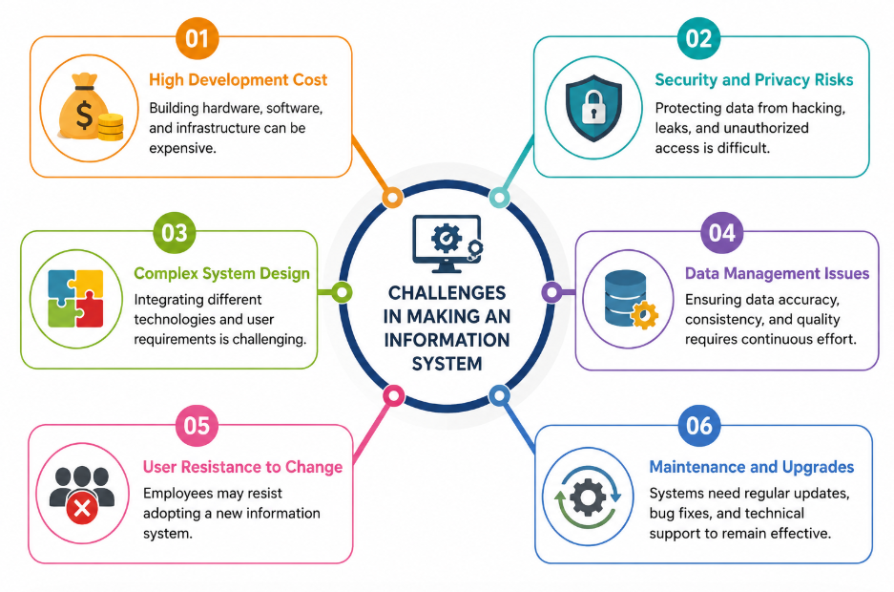

Slide 8
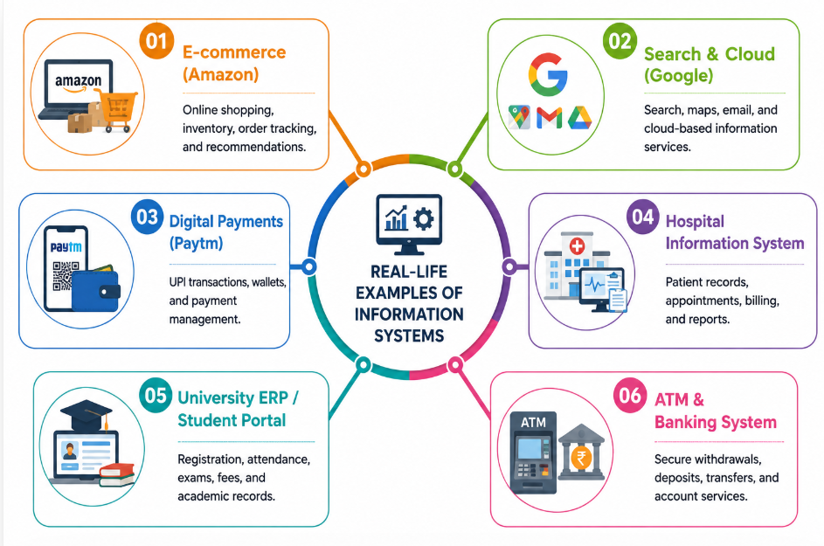

Slide 9
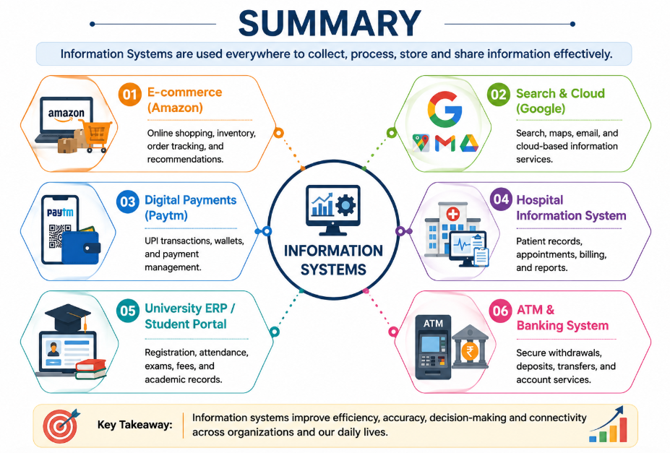

Slide 10
1. Which component of an Information System primarily transforms raw data into meaningful information?
A. Hardware
B. People
C. Processing
D. Networks
2. A company implements a new ERP system but employees continue using manual records. This situation best represents:
A. Data redundancy
B. User resistance to change
C. System scalability
D. Network failure
3. Which Information System activity is most closely associated with ensuring long-term availability of organizational knowledge?
A. Input
B. Processing
C. Output
D. Storage

